Slide 1

CSE 215 Group 8 Project
Online Shopping System

Slide 2

Objectives
Seamless shopping experience
Efficient inventory management
Java programming concepts: GUI, multithreading, file handling

Slide 3

Features
Customer Mode: Browse, add/remove items, checkout
Admin Mode: Manage products, view real-time stock updates

Slide 4
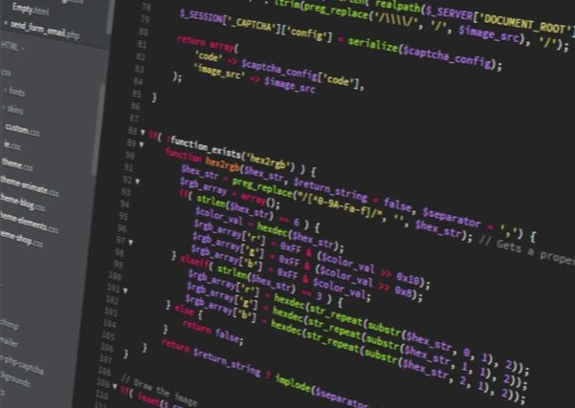
System Architecture
Product Class: Item attributes
ShoppingCart Class: Cart operations
Main Class: GUI coordination, multithreading, data handling

Slide 5

GUI
Built with Swing
Scrollable product list, buttons for cart actions
Visual cues for stock availability

Slide 6
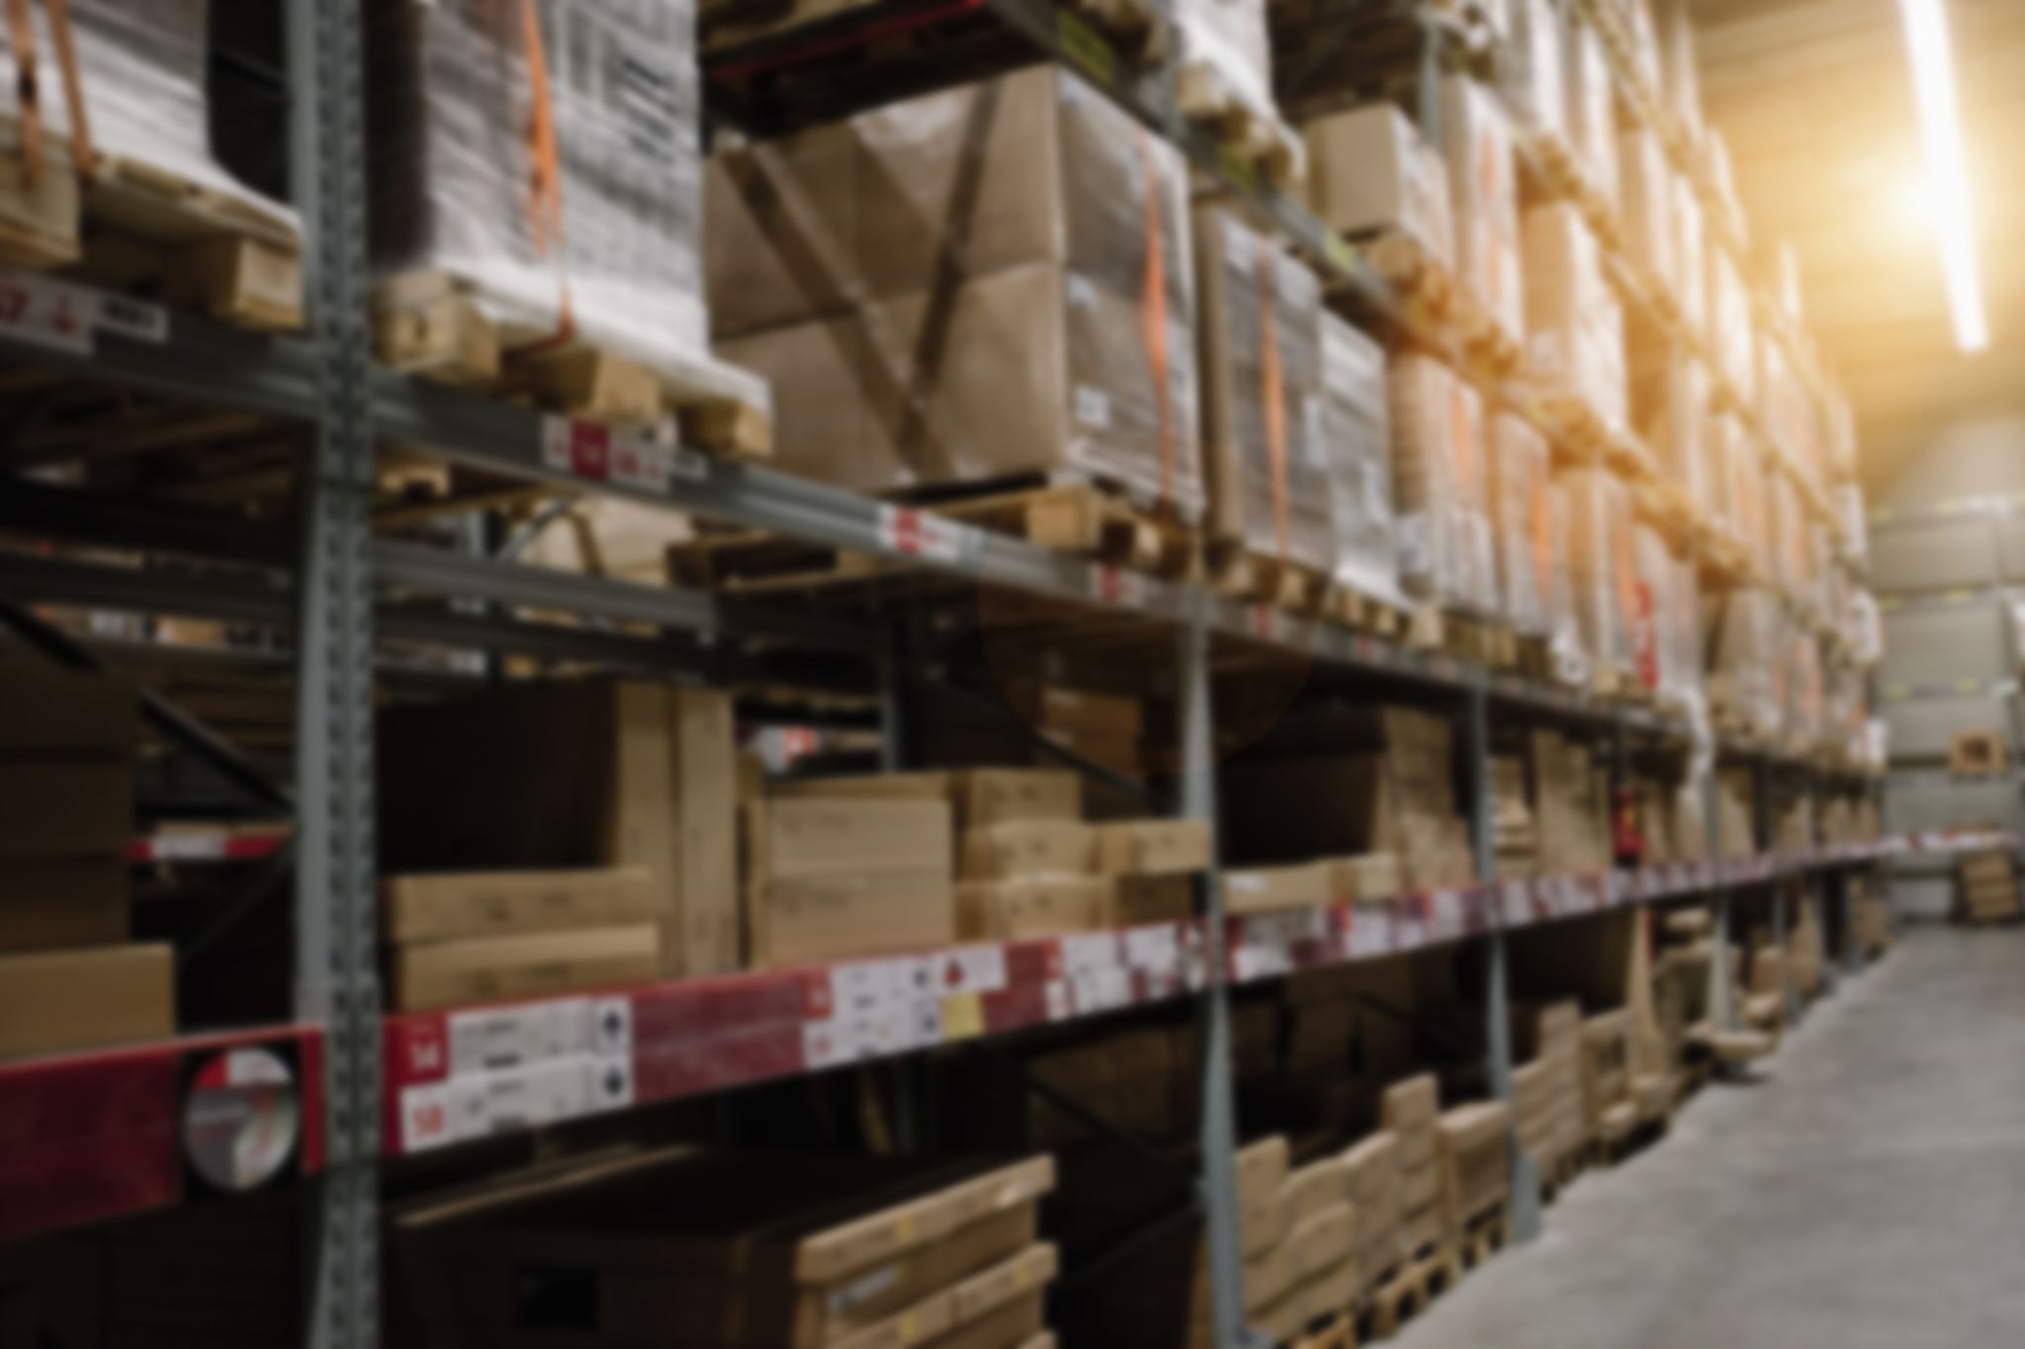
Admin Features
Add, update, search, and remove products
Easy inventory control

Slide 7

Customer Journey
Browse catalog
Search products
Add to cart
Checkout with total
Real-time updates

Slide 8
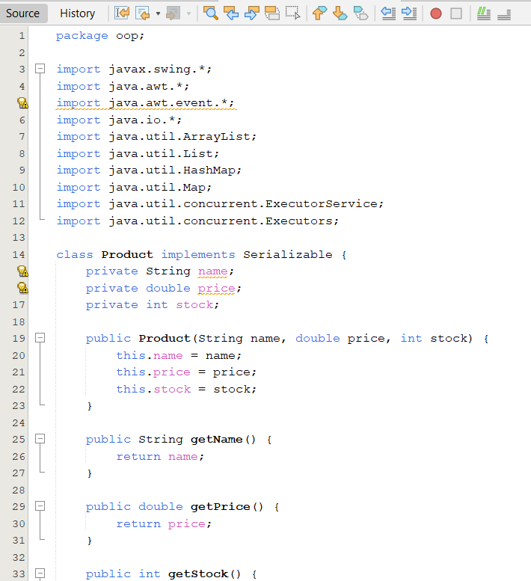
325 lines of code
Online Shopping System
Developed with Java to simplify e-commerce for customers and admins.

Slide 9
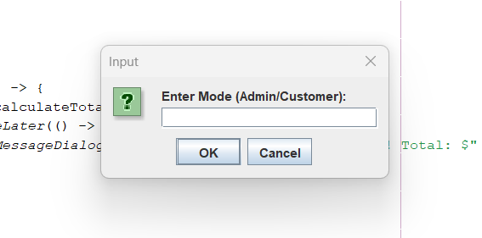
After clicking run

Slide 10
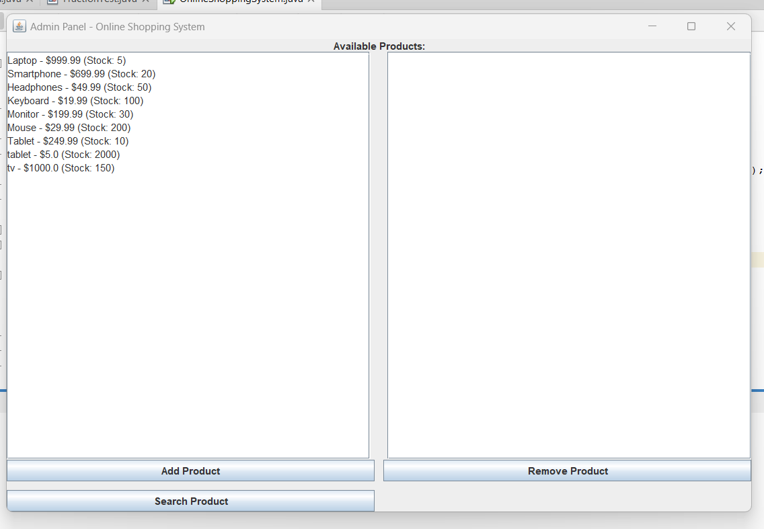
After clicking admin
Admin can see the available products

Slide 11
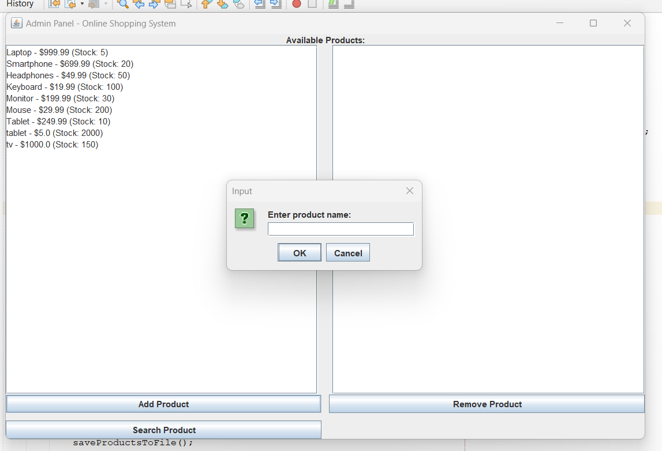
After clicking Add Product
Admin can add new product

Slide 12
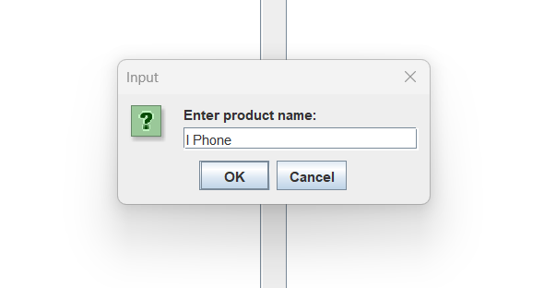

Slide 13
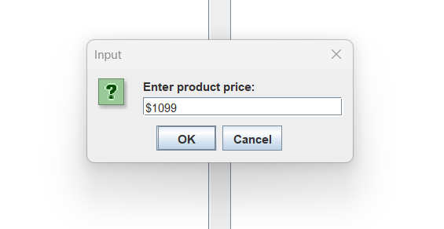

Slide 14
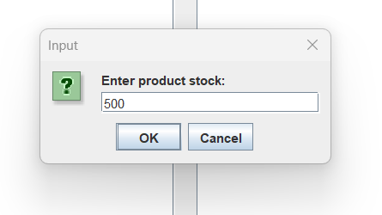

Slide 15
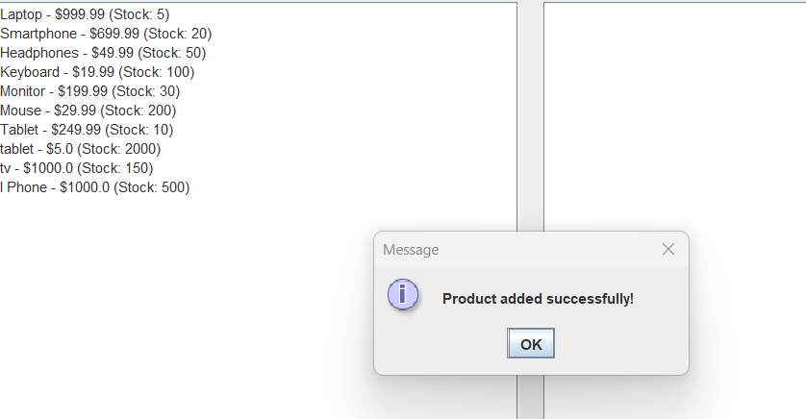

Slide 16
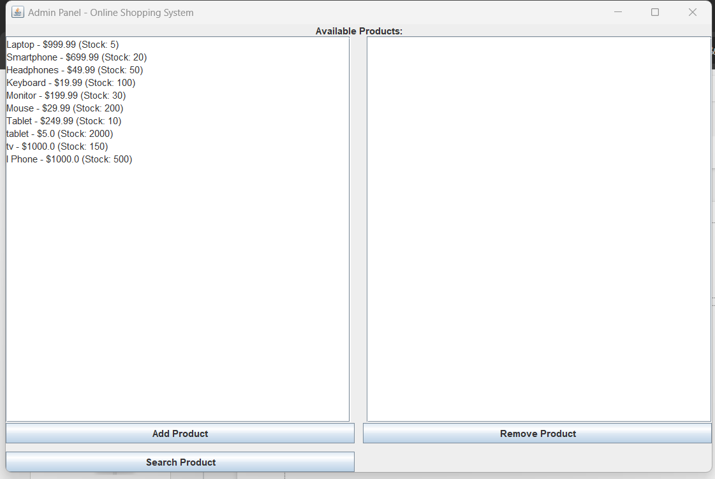

Slide 17
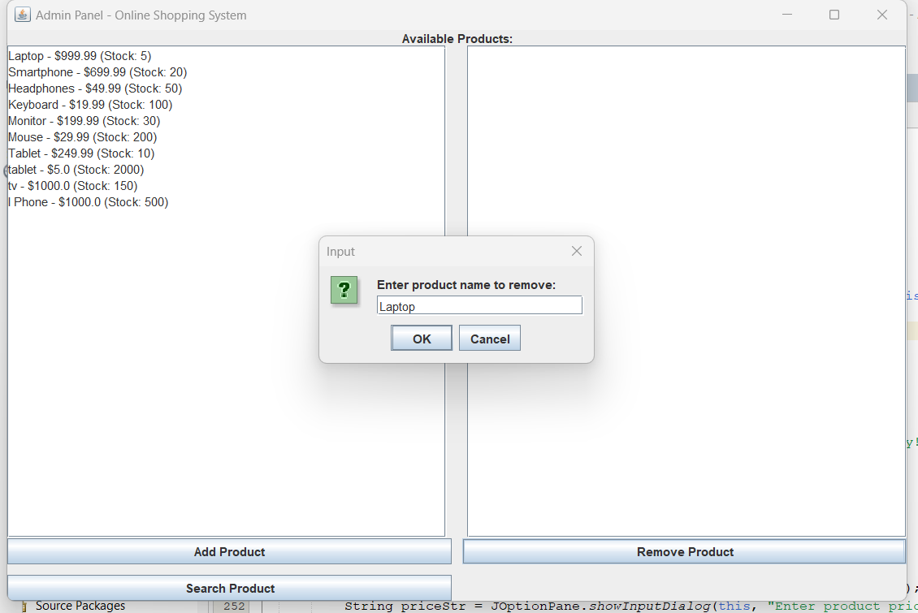

Slide 18
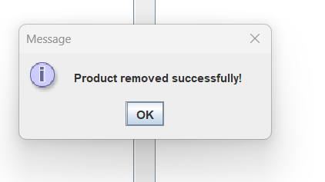

Slide 19
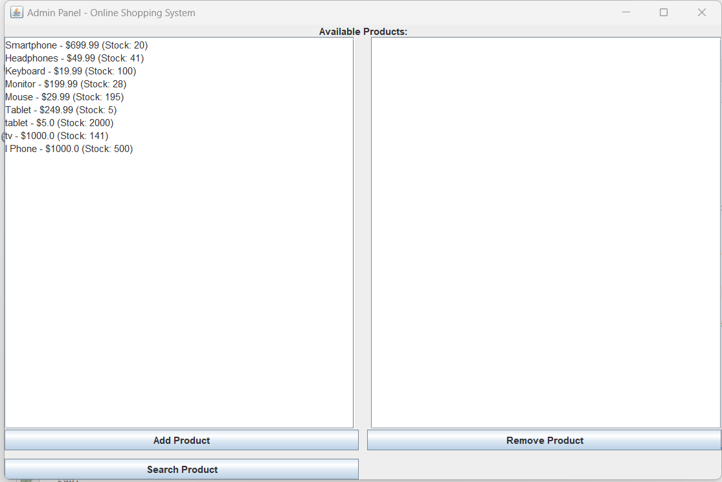

Slide 20
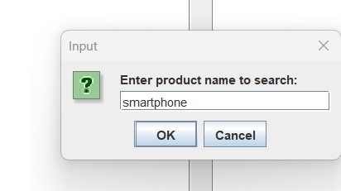

Slide 21
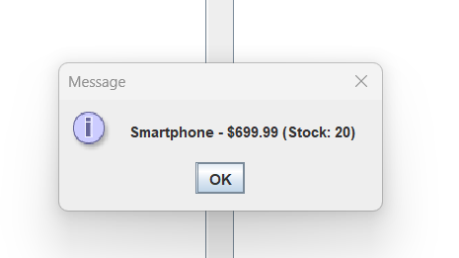

Slide 22
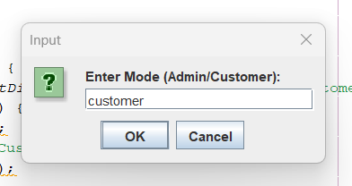

Slide 23
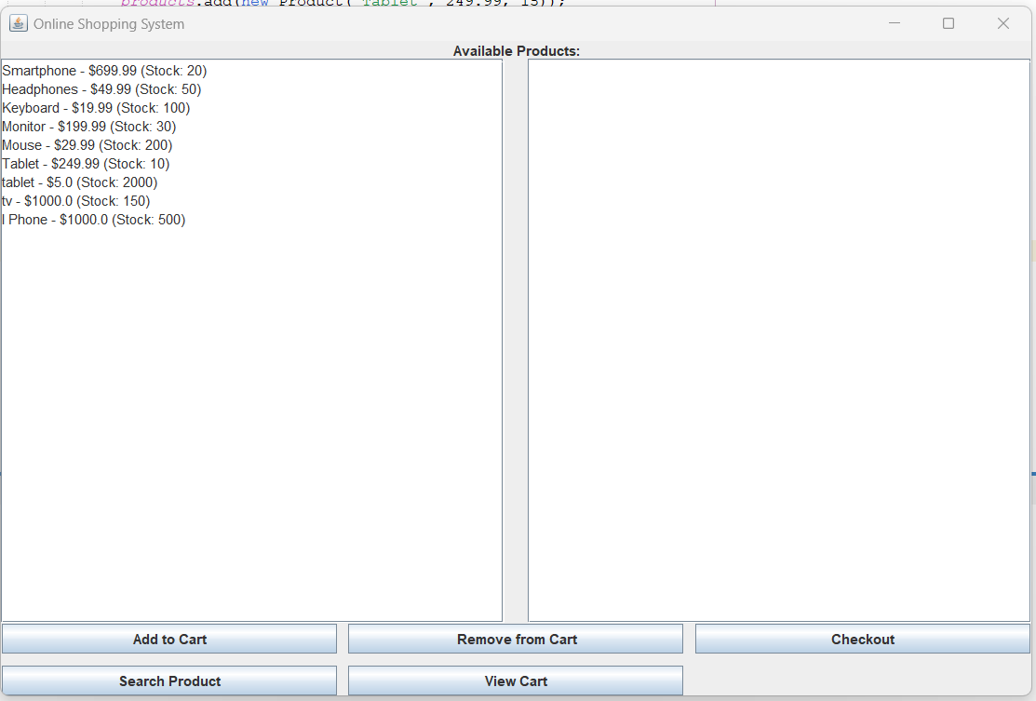

Slide 24
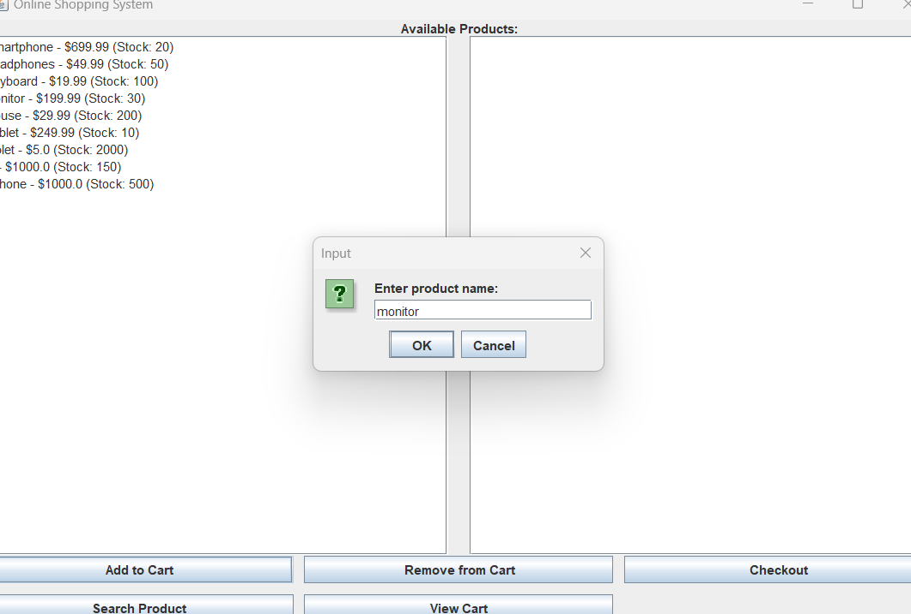

Slide 25
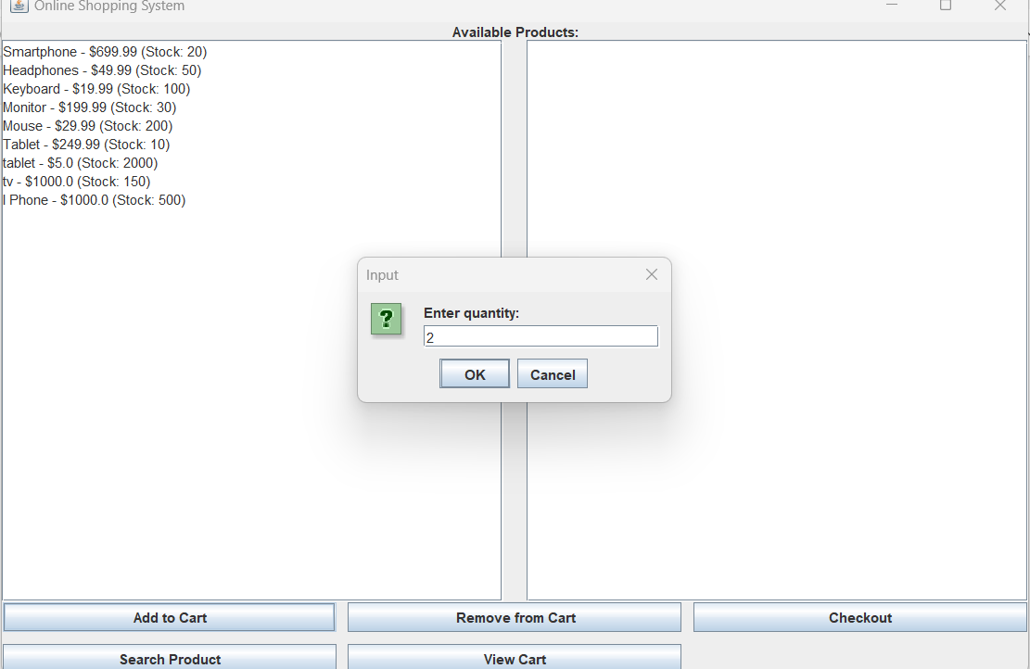

Slide 26
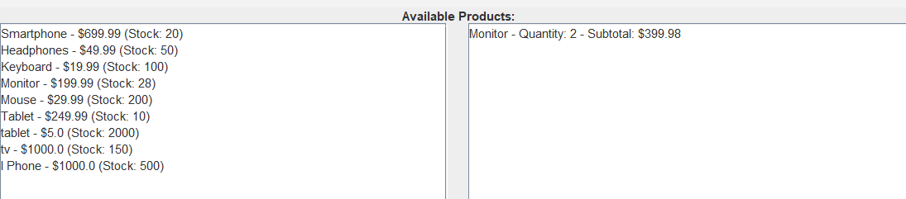

Slide 27
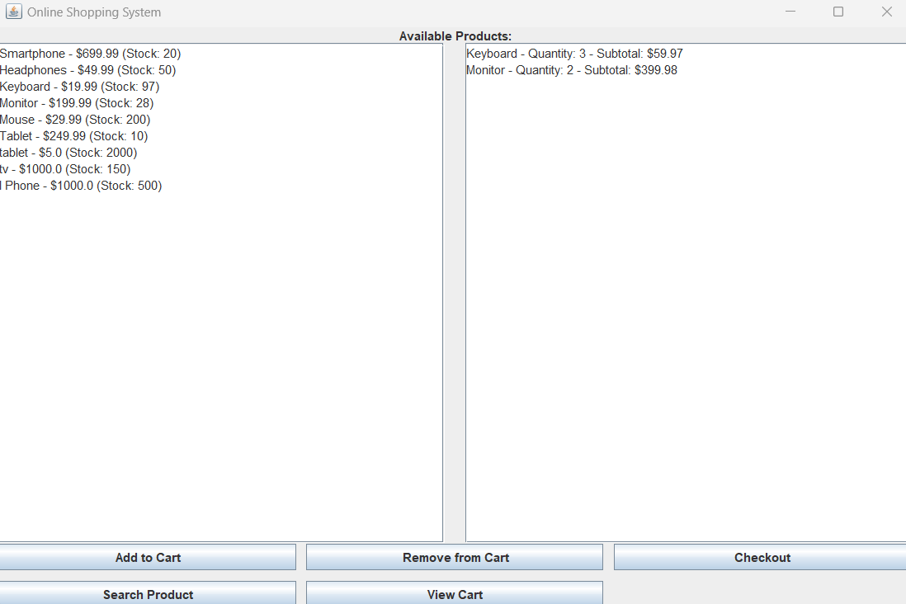

Slide 28
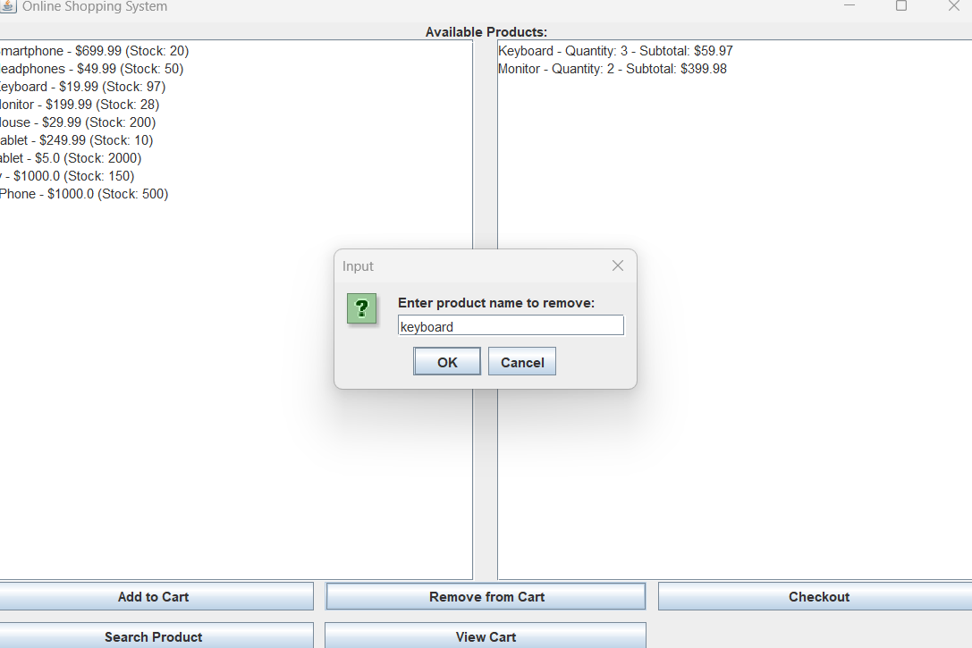

Slide 29
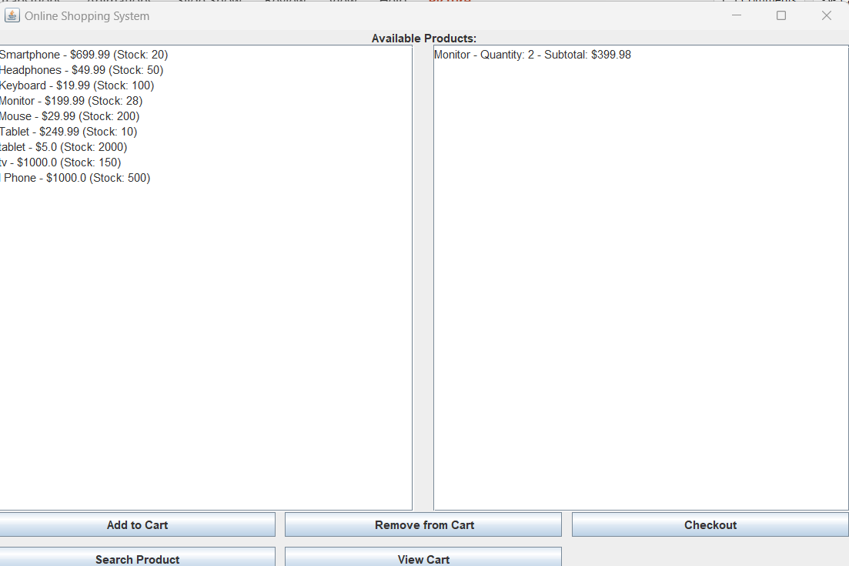

Slide 30
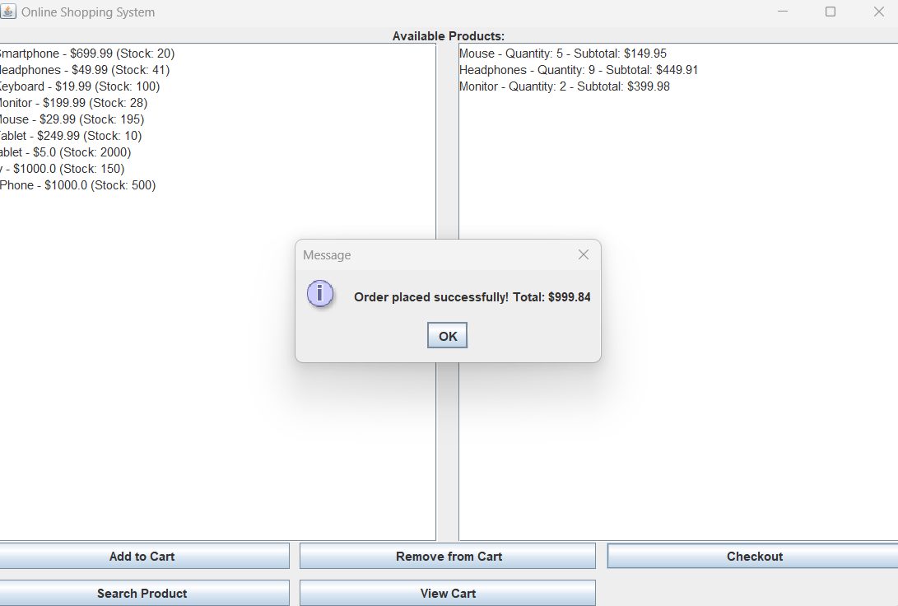

Slide 31
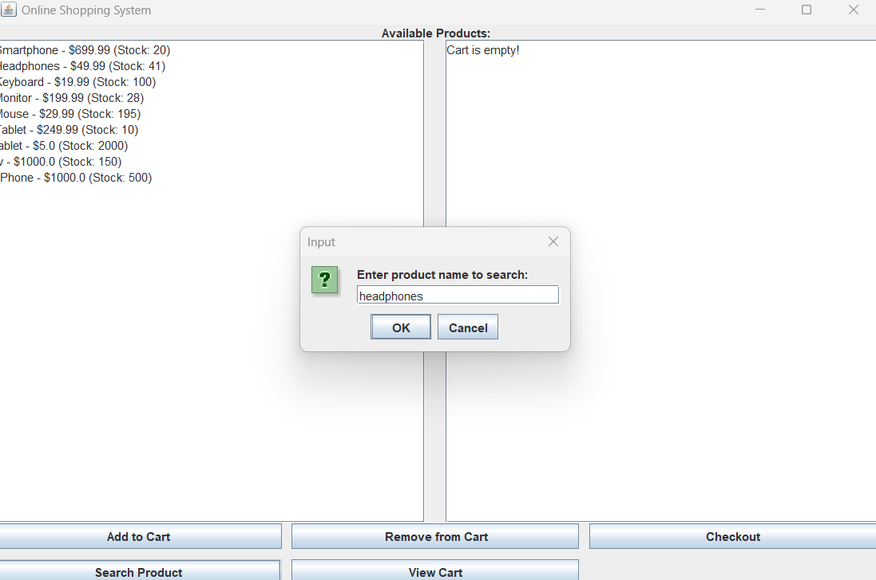

Slide 32
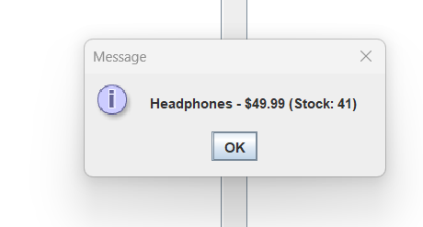

Slide 33
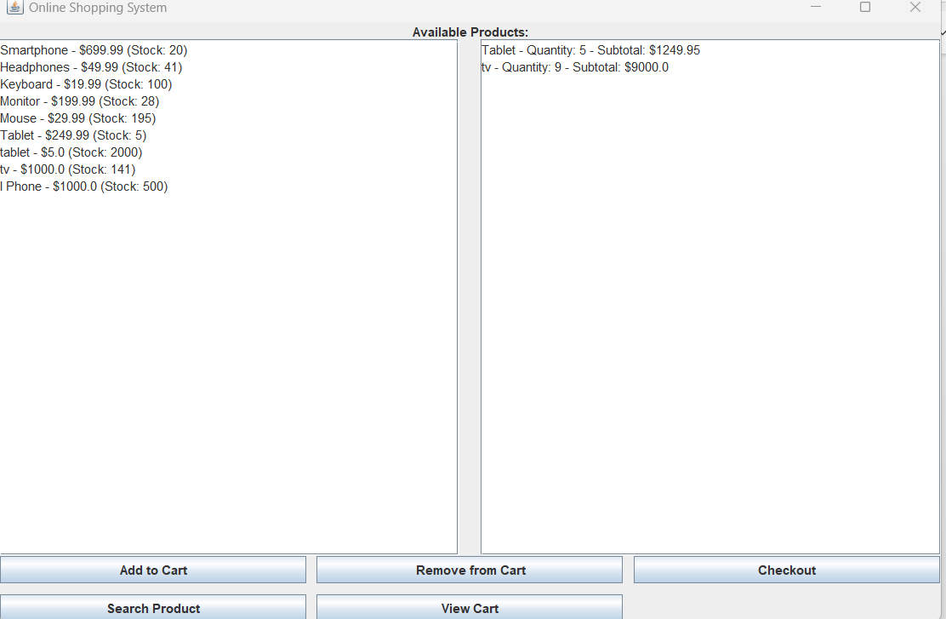

Slide 34


